Slide 1
Artificial Intelligence (Machine Learning & Deep Learning)
{
Recap Testing - Evaluation Metrics
}
...

Slide 2
Contents of Day 27
Recap & introduction | Moving from Python OOP to Data Science. Why AI needs data.
Core Thoery | Multivariate Linear Regression The Equation & The Weights. Feature Scaling (Fixing the Impressions bug). Training the Model with scikit-learn. Evaluation Metrics (MAE and R and R2 Score).
Lab Practice | Practical coding tasks implementing method
Advance Lab | Understanding the logic with real world examples.
Wrap-up & Q&A | Debugging tips along with Q&A and suggestion

Slide 3
What is Model Testing?
Training is only half the job. Testing is the other half.
Split your data:
* 80% Train → model learns from this
* 20% Test → model is evaluated on this
* Never let model see test data during training
The danger without testing:
* Model memorizes training data → fails on real world data
Test data = the real exam. Training = practice.

Slide 4
Why Accuracy Alone Lies
95% of emails are NOT spam.
A model that always says "not spam" gets 95% accuracy.
But catches zero actual spam.
Accuracy lied to us.
We need smarter metrics.
High accuracy on imbalanced data means nothing.

Slide 5
The Confusion Matrix
Confusion Matrix is a table used to evaluate how well a machine learning model is performing. It shows exactly where the model is getting things right and, more importantly, where it is getting "confused."
It compares the Actual values (the truth) against the Predicted values (what the model guessed).
Four possible outcomes for any prediction:
* TP → predicted positive, actually positive
* TN → predicted negative, actually negative
* FP → predicted positive, actually negative (false alarm)
* FN → predicted negative, actually positive (missed case)
Most dangerous: FN in medical diagnosis.
"Healthy" prediction for a cancer patient = deadly mistake.

Slide 6
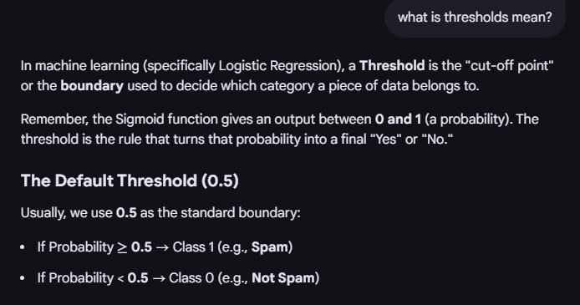
Precision and Recall
The Confusion Matrix breaks down exactly which category is failing, allowing you to calculate better metrics like:
Precision = out of everything I called positive, how many truly were?
Use when: false alarms are costly (spam filter)
Recall = out of all real positives, how many did I catch?
Use when: missing cases is costly (cancer detection)
The tradeoff:
* High Precision → fewer false alarms
* High Recall → catches everything but more false alarms

Slide 7
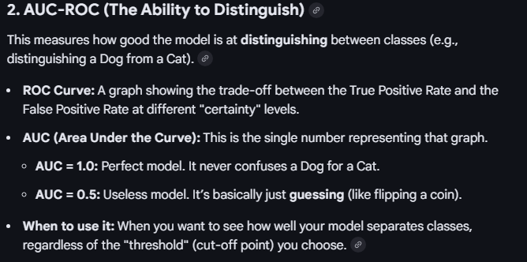
F1-Score and AUC-ROC
F1-Score balances Precision and Recall into one number. Use F1 when both mistakes matter equally or data is imbalanced.
> F1 = 2 × (Precision × Recall) / (Precision + Recall)
> > High F1-Score means your model is performing well on both fronts (catching the right cases without too many false alarms).
Example: In Cancer detection, if 99% of people are healthy, a model that says "Healthy" to everyone is 99% accurate but useless. The F1-Score would be very low here, exposing the model's failure to catch the 1% sick people.
AUC-ROC measures model quality across all thresholds.
* AUC = 1.0 → perfect model
* AUC = 0.5 → random guessing
Use AUC when dataset is imbalanced.

Slide 8
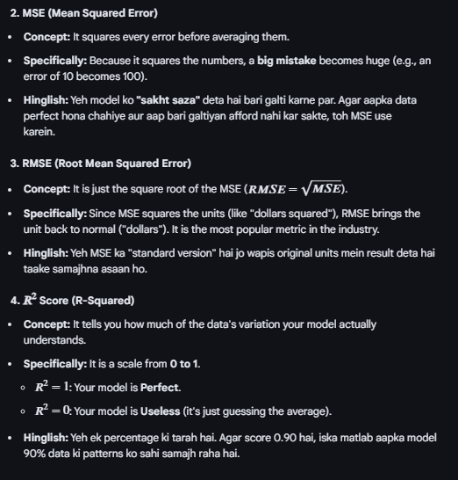
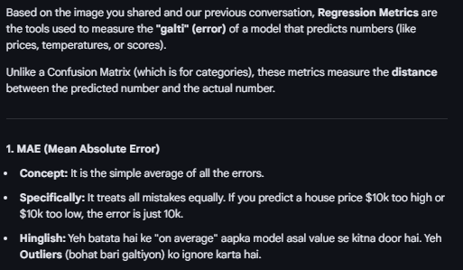
Regression Metrics (Regression predicts a number not a category.)

Slide 9
AI vs ML vs Deep Learning
Three nested levels. Not the same thing.
AI → makes machines seem intelligent (biggest circle)
ML → machines learn patterns from data (inside AI)
DL → neural networks with many layers (inside ML)
Simple analogy:
AI = the goal
ML = one method to reach it
Deep Learning = the most powerful method today

Slide 10
Machine Learning - Three Types
Supervised → learns from labeled data
Examples: spam detection, sentiment analysis
Unsupervised → finds hidden patterns, no labels
Examples: topic modeling, clustering
Reinforcement → learns by trial and error via rewards
Examples: games, ChatGPT training (RLHF)
NLP uses all three depending on whether you have labels.

Slide 11
Deep Learning - How It Works
Three layers in every neural network:
* Input layer → receives raw data
* Hidden layers → learn patterns automatically
* Output layer → produces the prediction
Training loop (repeats millions of times):
1. Make prediction
2. Measure error (loss)
3. Update weights (Gradient Descent)

Slide 12
ML vs Deep Learning - When to Use Which
Use Machine Learning when:
* Small dataset, limited compute
* Need explainable results
* Structured/tabular data
Use Deep Learning when:
* Large dataset, GPU available
* Unstructured data: text, images, audio
NLP rule:
Small task → TF-IDF + Naive Bayes
Large task → BERT or GPT BERT (Bidirectional Encoder Representations from Transformers)
is a Google AI model designed to understand the deep context of language by reading text in both directions, making it ideal for search and text classification.
GPT (Generative Pre-trained Transformer) is an OpenAI model specialized in generating fluent, human-like text by predicting the next word in a sequence

Slide 13
Dataset Imbalance - The Problem
Imbalance = one class has far more samples than another.
Example: 99% normal transactions, 1% fraud
What goes wrong:
* Model always predicts majority class
* Gets high accuracy but catches zero minority cases
Real danger:
95 healthy, 5 cancer patients.
Model says everyone is healthy.
Accuracy = 95% but all 5 cancer patients were missed.

Slide 14
Detecting Imbalance
Check your class distribution first.
from collections import Counter
Counter(y) → {0: 9500, 1: 500}
Ratio = 19:1 → serious imbalance
Severity guide:
* 1:3 → balanced, no action needed
* 1:10 → mild, consider fixing
* 1:100 → extreme, must fix aggressively
Sign of imbalance: high accuracy but near-zero Recall on minority class.

Slide 15
Remedy 1 - Resampling
Over sampling → add more minority samples
Under sampling → remove majority samples
Best method: SMOTE
* Creates NEW synthetic minority samples
* Not just copies → avoids overfitting
from imblearn.over_sampling import SMOTE
X_res, y_res = SMOTE().fit_resample(X, y)
SMOTE is the gold standard for fixing imbalanced datasets.

Slide 16
Remedy 2 - Text Augmentation
Augmentation creates new text by modifying existing samples.
Techniques:
* Synonym Replacement → "I love NLP" → "I adore NLP"
* Back Translation → English → Urdu → English
* Random Deletion → remove low-importance words
* Random Insertion → add synonyms into sentence
pip install nlpaug
import nlpaug.augmenter.word as naw
aug = naw.SynonymAug()
result = aug.augment("I love NLP")

Slide 17
Remedy 3 - Algorithm Fixes
Method 1: Class Weights
Penalize minority mistakes more heavily during training.
model = SVC(class_weight='balanced')
Method 2: Threshold Tuning
Lower decision threshold → catches more minority cases
Default = 0.5. Try 0.3 for higher Recall.
Method 3: Better Algorithms
XGBoost and Random Forest handle imbalance naturally.
Best practice: combine all three levels together.
Data fix + algorithm fix + correct metric = best results.

Slide 18
TfidfVectorizer - Text to Numbers
Converts raw text into a numerical matrix.
TF-IDF = Term Frequency × Inverse Document Frequency.
* Common words like "the" → low score
* Rare meaningful words like "fraud" → high score
from sklearn.feature_extraction.text import TfidfVectorizer
tfidf = TfidfVectorizer(max_features=3000)
X = tfidf.fit_transform(texts)
Output: a matrix of numbers ready for any ML model.

Slide 19
SelectKBest and chi2 - Feature Selection
SelectKBest keeps only the top K most useful features.
chi2 is the scoring method it uses.
Chi-Square measures how strongly each word
is linked to a specific class (spam vs ham).
from sklearn.feature_selection import SelectKBest, chi2
selector = SelectKBest(chi2, k=1000)
X_selected = selector.fit_transform(X, y)
Result: removes noise, faster and more accurate model.

Slide 20
train_test_split - Splitting Data
Splits dataset into training and testing portions.
Never evaluate a model on data it trained on.
That is cheating → model just memorizes answers.
80% goes to training. 20% goes to testing. from sklearn.model_selection import train_test_split
X_train, X_test, y_train, y_test = train_test_split(
X, y, test_size=0.2, stratify=y)

Slide 21
MultinomialNB - Naive Bayes
MultinomialNB is designed specifically for text data.
Uses Bayes theorem to calculate probability of spam
given the words inside the email.
"Naive" = assumes all words are independent of each other.
from sklearn.naive_bayes import MultinomialNB
model = MultinomialNB(alpha=0.1)
model.fit(X_train, y_train)
Best for: text classification on small datasets. Very fast.

Slide 22
LogisticRegression - Probability Classifier
Despite the name it is a classification algorithm.
Learns a weighted combination of features.
Passes result through Sigmoid function → probability 0 to 1.
from sklearn.linear_model import LogisticRegression
model = LogisticRegression(max_iter=1000)
probs = model.predict_proba(X_test)
Best for: when you need confidence scores per prediction.
Example output: "87% chance this email is spam."

Slide 23
LinearSVC - Support Vector Machine
One of the strongest classifiers for text data.
Finds the best boundary that separates spam from ham
with the maximum possible margin between classes.
from sklearn.svm import LinearSVC
model = LinearSVC(max_iter=2000)
model.fit(X_train, y_train)
Best for: high-dimensional text data.
Note: LinearSVC does NOT support predict_proba().

Slide 24
accuracy_score and classification_report
accuracy_score = correct predictions / total predictions.
accuracy_score(y_test, y_pred) → 0.97
Weakness: misleading on imbalanced data.
classification_report gives full table per class:
* Precision, Recall, F1 for each label
print(classification_report(y_test, y_pred,
target_names=['Ham', 'Spam']))
Always use classification_report over accuracy alone.

Slide 25
precision_score and recall_score
Precision = of everything predicted spam, how many truly were?
precision_score(y_test, y_pred) → 0.95
Use when: false alarms are costly (spam filter).
Recall = of all real spam, how many did model catch?
recall_score(y_test, y_pred) → 0.92
Use when: missing cases is costly (cancer detection).
The tradeoff: you cannot maximize both at the same time.

Slide 26
f1_score - Balancing Both
F1 Score is the balance between Precision and Recall.
Formula: 2 × (Precision × Recall) / (Precision + Recall)
f1_score(y_test, y_pred) → 0.93
* F1 = 1.0 → perfect model
* F1 = 0.0 → completely broken model
Use F1 when: BOTH false alarms AND missed cases matter.
Best default metric for any imbalanced text classification.

Slide 27
confusion_matrix - The Breakdown Table
Confusion Matrix shows the 4 types of predictions.
cm = confusion_matrix(y_test, y_pred)
Result: [[TN, FP], [FN, TP]]
* TP → spam caught correctly
* TN → ham passed correctly
* FP → ham wrongly flagged as spam
* FN → spam that slipped through (most dangerous)
Every metric (Precision, Recall, F1) is calculated from this table.

Slide 28
roc_auc_score and roc_curve
AUCROC measures overall model quality across all thresholds.
roc_auc_score(y_test, y_prob) → 0.98
* AUC = 1.0 → perfect model
* AUC = 0.5 → random guessing (useless)
roc_curve returns points to draw the ROC graph.
fpr, tpr, thresholds = roc_curve(y_test, y_prob)
Use AUC when: dataset is imbalanced or you need to
compare multiple models fairly on one chart.

Slide 29
SMOTE - Fixing Class Imbalance
SMOTE = Synthetic Minority Oversampling Technique.
Creates brand NEW synthetic minority samples.
NOT just copies → avoids overfitting.
How it works:
* Finds nearest neighbors in minority class
* Generates new points between them in feature space
from imblearn.over_sampling import SMOTE
smote = SMOTE(random_state=42)
X_bal, y_bal = smote.fit_resample(X, y)
Before: spam=747. After: spam=4825. Perfectly balanced.

Slide 30
Thank You for Your Focus Today!
What was the most confusing part of today's lab?
Waleed Khan (Robotics Engineer | Senior Python Developer)
Email: 0xcloudcoder@gmail.com Contact: +923126008702
}
*

